Slide 1
Infectious Complications of HSCT
Kristin Wessel, MD
Notes:
Policies/procedures section

Slide 2
Immune System Recovery after HSCT
Patients undergo conditioning regimen prior to HSCT as significant recipient immunosuppression is necessary to prevent graft rejection
2 broad categories of conditioning regimens most commonly used in pediatrics: myeloablative (MAC) and reduced intensity (RIC)
  MAC results in period of profound pancytopenia lasting days to weeks
  RIC reduces complications associated with MAC; useful for patients with preexisting comorbidities

Slide 3
Immune System Recovery after HSCT
Order of recovery: neutrophils→monocytes→NK cells→platelets→erythrocytes→B and T cells
Lymphocyte recovery takes the longest
  1-2 months: NK cell recovery
  2-8 months: CD8+ T cells, then B cells, then CD4+ T cells
Because of the prolonged recovery period of B cells and reconstitution of memory B cells, patients are predisposed to infections with encapsulated bacteria and viruses for at least 1 year, as presence of antibodies is crucial for fighting these types of infections

Slide 4
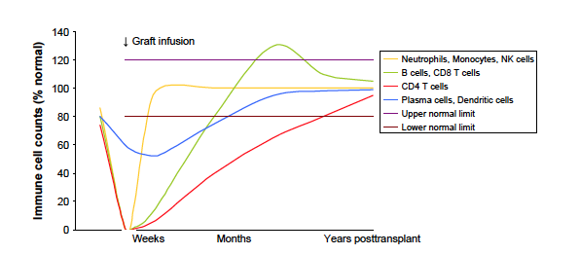
Approximate Immune Cell Counts Over Time Post-Transplant
¹ Tomblyn, M. , et al. Biol. Blood Marrow Transplant. 2009; 15: 1143-1238.

Slide 5
Phases of infectious complications
Time to engraftment is dependent on engraftment source
  14-20 days for peripheral blood or bone marrow recipients
  25-40 days for cord blood recipients
  Engraftment occurs sooner with autologous vs. allogeneic transplant, often in the first 10 days after transplant
Phase I: Preengraftment (<15-45 days)
  Characterized by prolonged neutropenia and breaks in mucosal barrier
  Risk for bacteremia, fungal infections (Candida, Aspergillus), HSV reactivation
Phase II: Postengraftment (30-100 days)
  Risk for infections controlled by T-cell mediated immunity: CMP, PCP, Aspergillus
Phase II: Late phase (>100 days)
  CMV, VZV, Aspergillus
  Patients with chronic GVHD, and allogeneic transplant recipients at greatest risk

Slide 6
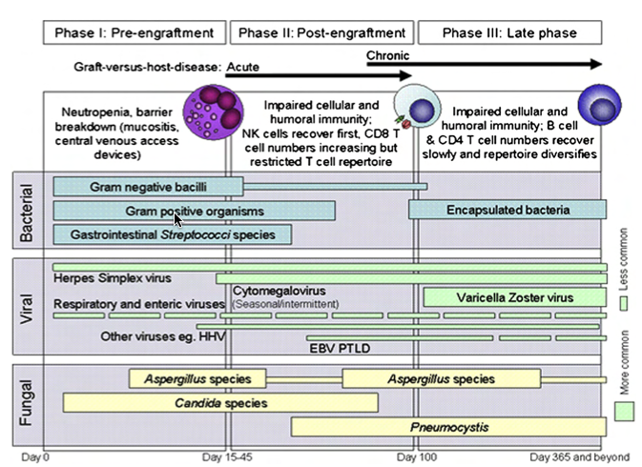
Opportunistic Infections: Timeline

Slide 7
Factors affecting risk of infection post-HSCT
Type of transplant
  Allogeneic transplant recipients are at greater risk for infection than autologous transplant recipients
Graft type
  Cord blood highest risk
  Bone marrow stem cell transplant intermediate
  G-CSF mobilized peripheral blood stem cells lower risk
  T cell-depleted graft carries higher risk

Slide 8
Bacterial Infection: Prophylaxis
No routine antibacterial prophylaxis for autologous transplants
Allogeneic transplant recipients receive metronidazole 7 mg/kg q8h IV until discharge
In febrile patients, follow febrile neutropenia pathway
G-CSF for allogeneic recipients receiving cord blood transplant
Notes:
*G-CSF

Slide 9
Viral Infection: CMV
  Pre-transplant evaluation: all recipients and donors should be tested for IgG Ab to determine risk for primary CMV infection/reactivation
  Prophylaxis: Indicated in autologous transplants with CMV-seropositive recipient; in allogeneic transplants with CMV-seropositive recipient and/or donor
    Day -7 through day -2: Ganciclovir 5 mg/kg IV q12h
    Day -1: Switch to acyclovir 10 mg/kg IV q8h (myelosuppression with ganciclovir)
    Engraftment: valacyclovir 30 mg/kg/dose PO QID (max 2g PO QID)
  HCT recipients at risk for post-transplant CMV should receive prophylaxis until day +210

Slide 10
Viral Infection: CMV
Surveillance
  CMV DNA PCR on admission, then QMonday while inpatient, continue weekly CMV PCR until day +100
Clinical manifestations
  May present as pneumonia, retinitis, colitis; syndrome with fever, thrombocytopenia, leukopenia and hepatitis
Treatment for CMV viremia
  Ganciclovir 5 mg/kg IV q12h x 14 days
  Note: can cause myelosuppression

Slide 11
Viral Infection: HSV
  Pre-transplant evaluation: Donors and recipients are tested for HSV IgG prior to transplant
  Prophylaxis: Indicated in autologous transplant for HSV-seropositive patients; and in allogeneic transplants with HSV-seropositive donor or recipient
    Autologous transplant:
      Acyclovir 250 mg/m² IV q12h starting day 0 until tolerating PO
      Acyclovir 600 mg/m²/dose PO BID (max dose 800 mg PO BID) until day +180
    Allogeneic transplant
      Acyclovir 10 mg/kg IV q8h from day -1 until engraftment and tolerating PO
      Acyclovir 600 mg/m²/dose PO BID (max dose 800 mg PO BID) until day +365 or until off immunosuppresants

Slide 12
Viral Infection: HSV
Clinical manifestations
  Most common: Mucocutaneous lesions in orofacial region
    This may be difficult to differentiate from mucositis-obtain PCR from lesions if mucositis is especially severe
  Less common: pneumonia, hepatitis, meningitis, encephalitis, bone marrow suppression
Evaluation
  HSV culture and PCR from lesions, PCR CSF if s/s meningitis, PCR from blood if concerned for disseminated infection
Treatment
  IV acyclovir 30 mg/kg/day in 3 divided doses for 7-14 days (Red Book 2015)
  Note: acyclovir is nephrotoxic, dose must be adjusted in renal impairment

Slide 13
Viral Infection: EBV
  HCT donors and recipients should be tested for serum anti-EBV IgG antibodies prior to transplant to determine risk for primary EBV after HCT
  EBV associated with Post-transplant lymphoproliferative disorder (PTLD)
  Factors increasing PTLD risk: T cell-depletion, use of anti-T cell mAb, UCB transplant, haplo-identical transplant

Slide 14
Viral Infection: EBV
Clinical manifestations
  PTLD, encephalitis/myelitis, pneumonia, hepatitis
Evaluation
  EBV PCR
Treatment
  PTLD: Rituximab, decrease immunosuppressive therapy
  Anti-viral agents not recommended for EBV prophylaxis
  Anti-viral agents (acyclovir, valacyclovir, ganciclovir) may be used in actively replicating EBV infection

Slide 15
Viral Infection: VZV
  Recipients should be tested for serum anti-VZV IgG antibodies
  All recipients should be informed of potential seriousness of VZV disease among immunocompromised patients
  Household contacts and potential visitors should be vaccinated as soon as decision is made to perform HCT, and complete vaccination schedule 4-6 weeks before HCT is performed
  HCT recipients with VZV disease should be placed under airbone and contact precautions
  Acyclovir ppx recommended for first year after HCT for VZV-seropositive allogeneic and autologous HCT recipients, valacyclovir may be used as alternative oral medication

Slide 16
Viral Infection: VZV
Clinical manifestations
  Vesicular rash, in SCT patients may involve entire body
  Abdominal pain, nausea, vomiting (may precede rash)
  Disseminated disease: encephalitis, hepatitis, pneumonia
  Visceral dissemination may occur without development of vesicular rash
  Might see elevation in AST/ALT, pancreatic enzymes, hyponatremia (SIADH)
Evaluation
  PCR from vesicles, throat swab or blood

Slide 17
Viral Infection: VZV
Treatment
  Any HCT recipient or candidate undergoing conditioning therapy who experiences VZV-like rash should receive IV acyclovir until 2 days after all lesions have crusted
  Indications for VZIG or VariZIG:
    Immunocompromised HCT recipients should receive ASAP, no later than 96h after close/household contact has chickenpox or shingles
    Can also use post-exposure acyclovir or valacyclovir as 2nd line

Slide 18
Viral Infection: Adenovirus
Adenovirus
  Infection can result for reactivation or de novo infection
  Low risk: autologous HCT
  Intermediate risk: T cell replete, related donor allograft recipients without GVHD
  Higher risk: recipients of T cell-depleted related or unrelated donor transplants, HLA-mismatched transplant recipients other than allele DRB1 mismatch, patients with GVHD who are receiving systemic steroids, pediatric recipients
  Highest risk: refractory GVHD, UCB transplant, haploidentical transplant, stem cell graft T cell depletion of >2-3 log(10), use of anti-T cell antibodies
  For highest risk patients, weekly monitoring for active adenovirus infection by PCR for either the first 6 months after HCT or the duration of severe immunosuppression/lymphopenia could be considered

Slide 19
Viral infection: Adenovirus
Clinical manifestations
  Disseminated disease can be life-threatening
  Severe pneumonia, hepatitis, meningitis, encephalitis, conjunctivitis
Evaluation
  PCR at least weekly until day +100
Treatment
  Supportive care
  Few antiviral agents have in vivo activity against adenoviruses-cidofovir has been found to reduce viral load but no clear benefit to preventing mortality
  Brincidofovir currently being studied in immunocompromised patients, you will see pediatric patients at UCMC on this drug

Slide 20
Viral Infection: Polyomaviruses
Polyomaviruses-BK (Human polyomavirus I) and JC (Human polyomavirus II)
Infect 50-90% of humans before age 10
Urinary shedding of BKV/JCV occurs in 5-20% if healthy immunocompetent blood donors
Polyomavirus disease in HCT patients most often corresponds to secondary BKV replication with impaired polyomavirus-specific cellular immunity
Urinary shedding of BKV occurs in 60-80% of HCT recipients

Slide 21
Viral Infection: Polyomaviruses
Clinical manifestations
  BKV-associated hemorrhagic cystitis (PVHC)
    Affects 5-15% HCT recipients 3-6 weeks post-transplant
    Usually occurs after engraftment
    If HC arises pre-engraftment, think about urotoxic conditioning regimens (cyclophosphamide, ifosfamide, Busulfan, TBI)
  Progressive multifocal leukoencephalopathy (PML)
    Associated with JCV
    Demyelinating disease of CNS
Evaluation
  PVHC: PCR in plasma, urine cytologic testing, but is mostly clinical diagnosis
  PML: compatible clinical syndrome, imaging, brain biopsy, JCV DNA in CSF

Slide 22
Viral Infection: Polyomaviruses
Treatment-restoration of immune function, data not convincing on antivirals
  PVHC: supportive (after engraftment immune system will control replication), cidofovir has also been used
  PML: Cidofovir has been used, but not consistently effective

Slide 23
Viral Infection: HBV
  Pre-transplant evaluation: testing both recipients and donors for evidence of active or past HBV infection is critical
    HBsAg, anti-HBsAg, anti-HBs, anti-HBc
  Clinical manifestations:
    Severe hepatitis
  Treatment
    Supportive

Slide 24
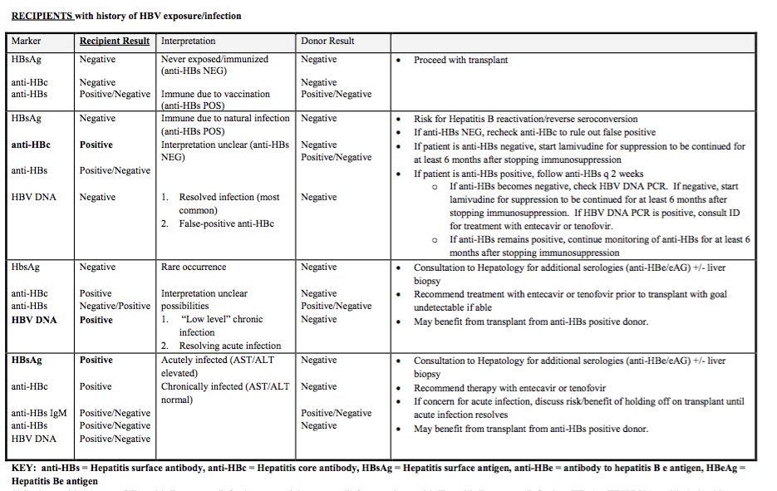
Recipients with history of HBV exposure or infection
Source: UCMC SOP “Antimicrobial Prophylaxis” 2013

Slide 25
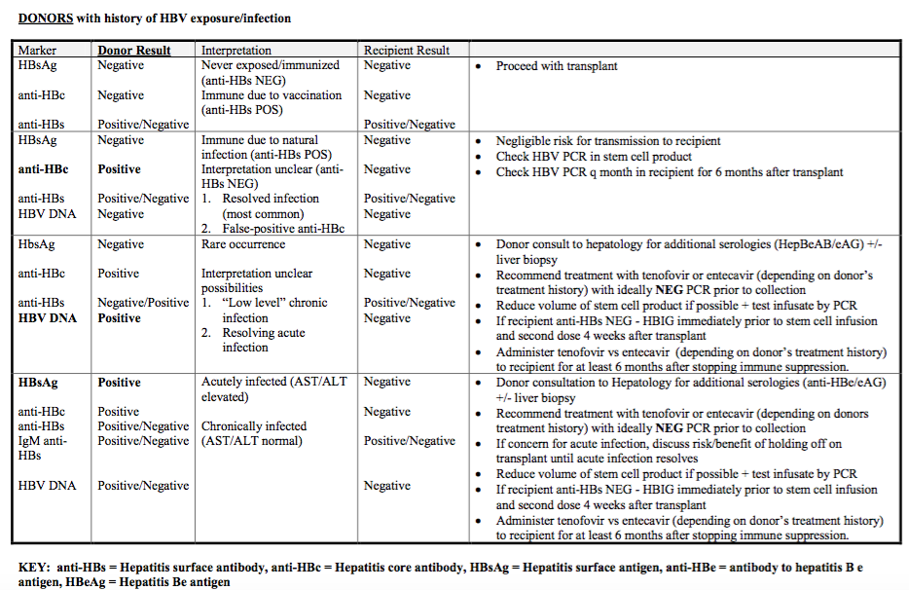
Donors with history of HBV exposure or infection
Source: UCMC SOP “Antimicrobial Prophylaxis” 2013

Slide 26
Fungal Infection: prophylaxis
Some patients receive GM-CSF or G-CSF post transplant, however this has not been shown to reduce the rate of invasive fungal disease
Patients will receive topical antifungals (nystatin, clotrimazole troches)
  May reduce colonization by yeasts and molds in the area of application
  Have not been proven to decrease risk for locally invasive or disseminated yeast or mold infections
Autologous transplant
  Prophylaxis with fluconazole, day -2 until day +180
Allogeneic transplant
  Micafungin 1 mg/kg IV daily (max 50 mg) from day -2 until discharge
    Treatment dose is 3 mg/kg IV daily with max 150 mg
  Patients will be discharged or oral voriconazole
    <25 kg: 3-5 mg/kg/dose q12h
    <40 kg: 100 mg q12h
    >40 kg: 200 mg q12h
  Prophylaxis continued until patient is off immunosuppressive therapy for 2 months

Slide 27
Yeast Infections (Candida)
Risk of infection increases during early posttransplant phase (phase I) due to neutropenia, mucositis and presence of central venous catheters
In phase II, risk increases with GI GVHD
Invasive candidiasis usually caused by dissemination of endogenous candida species that have colonized a patient’s GI tract
Risk is minimal during autologous transplant once neutropenia and mucositis have resolved
Prophylaxis: fluconazole is drug of choice, start from beginning of conditioning, alternative is micafungin (IV)

Slide 28
Mold Infections
Result primarily from respiratory exposure to and direct contact with fungal spores
Trimodal incidence distribution:
  Phase I, before engraftment-main risk factor is prolonged neutropenia, increased risk with BM and UCB transplants, lower with PB and NMA transplants
  Patients with prolonged low-level neutropenia prior to transplant (e.g. aplastic anemia)
  Phase II-main risk factor is cell-mediated immunodeficiency caused by GHVD and treatment
  Fluconazole has no activity against molds, however voriconazole and posaconazole do have activity

Slide 29
Pneumocystis jirovecii
Prophylaxis indicated for autologous and allogeneic transplant recipients
  TMP-SMX 4-6 mg/kg/day divided BID starting at admission through day -2, then discontinue as can cause myelosuppression, can delay engraftment
  At platelet engraftment, re-start TMP-SMX BID three times per week until day +365, or 3 months off immunosuppressive therapy
  Monthly pentamidine is alternative which carries less risk for myelosuppression
    300 mg via inhalation monthly if patient at least 5 years old and can tolerate
    4 mg/kg/dose IV q4 weeks if patient too young or cannot tolerate neb
  Atovaquone is next preferred alternative
    4-24 months: 45 mg/kg daily
    1-3 months or >24 months: 30 mg/kg daily (max 1500 mg daily)
  Dapsone 2 mg/kg/day (max 100 mg po daily)
TMP-SMX also covers Toxoplasma, nocardia, enteric pathogens, plasmodium, urinary pathogens
Mortality in immunocompromised patients: 5-40% with treatment, approaches 100% without treatment

Slide 30
Pneumocystis jirovecii
Clinical manifestations
  Fever, hypoxia, tachypnea, nonproductive cough
Evaluation
  Best is visualization of organisms from open lung biopsy or transbronchial biopsy
  Silver stain or PCR can be used for diagnosis
  Diagnosis also possible from bronchoscopy with bronchoalveolar lavage or sputum induction
Treatment
  IV TMP-SMX for 14-21 days is treatment of choice
  Alternative is IV pentamidine if cannot tolerate TMP-SMX or if no improvement with initial treatment

Slide 31
References
Styczynski, et al. 2009. Management of HSV, VZV and EBV infections in patients with hematological malignancies and after SCT: guidelines from the Second European Conference on Infections in Leukemia. Bone Marrow Transplantation, 43: 757-770.
Tomblyn et al. 2009. Guidelines for Preventing Infectious Complications among Hematopoietic Cell Transplantation Recipients: A Global Perspective. Biol Blood Marrow Transplant 15: 1143-1238.
Red Book 2015
Pisano, J. “Antimicrobial Prophylaxis”. 2013. https://services.uchospitals.edu/sites/PoliciesAndProcedures/HemOnc%20Transplant/Patient%20Care%20Policies/P211%20Antimicrobial%20Prophylaxis.pdf

