Slide 1
Oncologic Emergencies
Mimi Boren and Kristin Wessel

Slide 2
Fever and Neutropenia: Background and Definition
Fever can be the first sign of life-threatening infection in neutropenic onc patients
Fever is defined as temperature ≥ 38.3 C or ≥38.0 C for >1 hour
Neutropenia meeting criteria for treatment is absolute neutrophil count <500/mm³, or ANC <1000/mm³ which is expected to drop to <500/mm³ within 48 hours
Patients with “functional neutropenia” should be treated according to the same guidelines as patients with ANC <500. These are patients with hematologic malignancies who do not have functioning neutrophils. An example would be a patient newly diagnosed with ALL undergoing induction chemotherapy.
Onc patients with serious infections might not mount a fever; consider infection in patients who are hypothermic, hypotensive, or listless

Slide 3
History and Physical Exam of
Febrile Neutropenic Patient
Important aspects of history: primary oncologic diagnosis, site-specific symptoms (i.e. pain and warmth around port site), infection exposures, history of documented infections or colonization, concomitant noninfectious causes of fever (i.e. receipt of blood products)
Determine when they last had myelosuppressive chemotherapy. ANC typically reaches nadir 7-14 days after receiving myelosuppressive chemotherapy
Closely look at skin, especially folds, areas surrounding nail beds, central line sites, sites of bone marrow aspiration and lumbar punctures
Closely look in oropharynx, especially at the gums
To be thorough examining the perineum, particularly the perianal and labial regions
Remember: neutropenic patients will not have purulence at sites of infection (need neutrophils to make this!). Serial exams are needed to monitor for changes.

Slide 4
Work-up and Management of Fever and Neutropenia
Refer to Pediatric Febrile Neutropenia Clinical Pathway on UCMC Intranet (Clinical→ Physician resources →Antimicrobial Stewardship Program)
Goal: Initiation of antimicrobial therapy within 60 minutes of presentation. Do not wait to start antibiotics in order to obtain labs if they cannot be obtained in this time period
CBC with diff and CMP
Blood culture (from each lumen of central line)-usually do not obtain peripheral cultures in pediatric patients
UA and urine culture
RVP
Daily blood cultures as long as the patient is febrile
Cultures and/or imaging of other sites if suspected infections
Important: rectal temperature readings, digital rectal exams, medications per rectum, NG tubes and urine catheterization should be avoided in neutropenic pts because of risks of mucosal trauma and bacteremia

Slide 5
Antimicrobial Therapy for F&N
Initial therapy should have pseudomonal coverage. At Comer, ceftazidime 50 mg/kg q8h is usually the initial choice and does not require ID approval for use in F&N.
Vancomycin/linezolid: may be added for pneumonia, skin/soft tissue infection, substantial mucositis, suspected catheter-related infection, septic physiology, history of MRSA bacteremia
Aminoglycosides (e.g. gentamicin): add when gram-negative bacteremia is confirmed for double coverage, or in patients with septic physiology
Metronidazole: add when there are abdominal symptoms or if C. difficile infection is suspected, can also be used for anaerobic coverage in patients with severe mucositis
Clindamycin: can consider for anaerobic coverage in patient with severe mucositis
Antifungals: consider occult fungal infection when fever is persisting for >96 hours on broad-spectrum antibiotics and when there is no identified source of infection

Slide 6
Management of F&N on the floor: When can we stop antimicrobials?
Treatment for F&N is usually discontinued when the following criteria are met:
  Negative blood cultures for 48 hours
  Afebrile for 24 hours
  Rising ANC

Slide 7
Typhlitis
Also known as neutropenic enterocolitis, occurs from bacterial invasion of bowel wall, most often the cecum, during prolonged periods of neutropenia
Usually breakdown of gut mucosal integrity is due to cytotoxic chemotherapeutic agents
Consider this in the neutropenic patient with fever and abdominal pain
May also see bloody or watery diarrhea, vomiting, nausea

Slide 8
Typhlitis (cont.)
Dx: CT with contrast is best imaging modality
Management: bowel rest, NG to suction, IVF, and empiric antibiotics
Possible antibiotic regimens need to cover both pseudomonas and gut flora: piperacillin-tazobactam or ceftazidime plus metronidazole

Slide 9
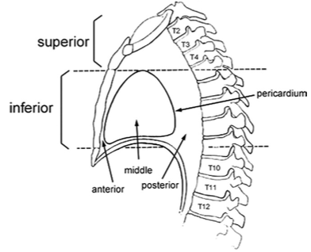
Anterior mediastinal mass
Most common tumors occurring in the anterior mediastinum can be remembered by the “4 T’s”: Thymoma, Teratoma, Thyroid and “Terrible” Lymphoma
Lymphomas are most common anterior mediastinal tumor in children (45%)
  2/3 are NHL, 1/3 are HL
  NHL more likely to present with symptoms; lymphoblastic T cell tumors have a doubling time of as little as 12 hours and can present emergently
Source: Seminars in Anesthesia, Perioperative Medicine and Pain (2007) 26, 133-140

Slide 10
Anterior mediastinal mass: Clinical Presentation
Symptoms result from compression of adjacent structures
Tracheal or bronchial compression
  Tracheomalacia may result from chronic compression and can present with cough, dyspnea, dysphagia, chest pain, recurrent pulmonary infections
  Orthopnea
  Fixed tracheal narrowing will lead to restriction of airflow during both inspiration and expiration; child may be symptomatic at rest
  Variable obstruction results in more symptoms during expiration (positive intrathoracic pressure leads to increased compression)
Pleural involvement ➔ pleuritic chest pain, pleural effusion
Cardiovascular
  Pericardial effusion/cardiac tamponade/constrictive pericarditis
  Superior vena cava syndrome

Slide 11
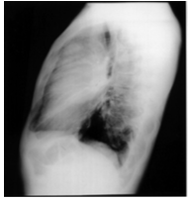
Anterior mediastinal mass: diagnosis
Often diagnosed from incidental finding on CXR
PA/lateral CXR
CT for staging, biopsy planning, and evaluation of compression of surrounding structures
MRI as accurate as CT, however use limited by cost and processing time
Biopsy needed for definitive diagnosis
Source: Seminars in Anesthesia, Perioperative Medicine and Pain (2007) 26, 133-140

Slide 12
Anterior mediastinal mass: management
Anatomic location of these tumors presents unique challenges for management
Important to balance need for imaging and surgical procedures with patient comfort and safety
Supine positioning may worsen airway compression; decubitus or prone positioning may be required
Patients are at risk for cardiorespiratory collapse during anesthesia
  Tumor sits above heart, great vessels and tracheobronchial tree while patient is in supine position→ gravity pulls mass down to compress these structures
  Loss of negative intrathoracic pressure during induction of anesthesia increases risk for compression of trachea, right side of heart and pulmonary artery
  Positive pressure ventilation must be avoided
Positioning child in left decubitus or prone position can help to restore ventilation and cardiac output in setting of cardiopulmonary collapse

Slide 13
Superior Vena Cava Syndrome
SVC is obstructed and get reduction in venous return from head, neck, and upper extremities
Obstruction may be from mass compressing SVC or thrombosis in SVC, thrombosis may occur from long term indwelling central lines
Signs: dilation of veins in head or arms, edema of arms, face, and neck, pleural effusions
Symptoms: cough/dyspnea, dysphagia, orthopnea, wheezing
Cardiorespiratory symptoms at rest suggests airway and vascular obstruction and limited physiologic reserve

Slide 14
SVC Syndrome (cont.)
Cardiac arrest and resp failure can occur when receiving sedatives or undergoing anesthesia-important!!!
Dx: usually clinical, on CXR may see mediastinal mass and on CT may see diminished opacification of central venous structures with prominent collateral venous circulation
Tx: low threshold to start O2, elevate head of bed, start diuretics, maintain calm and quiet environment. Heparin if there is a clot causing this. Steroids after diagnosis of type of malignancy has been made.

Slide 15
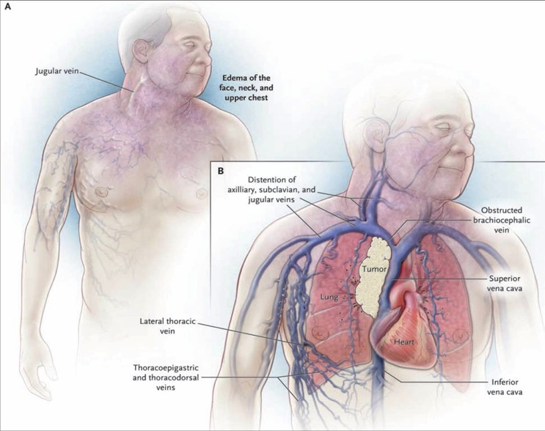
Superior Mediastinal Syndrome
Superior vena cava syndrome plus tracheal compression
May require emergent intubation!

Slide 16
Hyperleukocytosis
WBC > 100,000/mm³
Occurs in 10-20% of children with newly diagnosed acute leukemia
Associated with severe morbidity and mortality through the following:
  Leukostasis
  Tumor lysis syndrome
  Disseminated intravascular coagulopathy (DIC)
Poor prognostic indicator for both AML and ALL
Tx: Supportive care and cytoreduction through leukapheresis, induction chemotherapy, hydroxyurea

Slide 17
Leukostasis
High WBC count leads to tissue hypoxia through vascular obstruction
Incidence higher in myeloid leukemia vs lymphoid leukemia-myeloblasts have almost double the volume of lymphoblasts and therefore result in greater increase in leukocrit; myeloblasts also promote own adhesion to endothelium through secretion of cytokines and activation of endothelial cells
CNS and lungs most commonly affected sites
  CNS manifestations: altered mental status, headache, vision changes, tinnitus, ataxia, focal neurologic deficits and retinal hemorrhages on exam
  Pulmonary manifestations: tachypnea, dyspnea, hypoxemia
Other manifestations: priapism, acute leg ischemia, renal vein thrombosis
Diagnosis is rarely definitive; aggressive treatment usually initiated as soon as any of the above symptoms are present
Treatment is emergent leukapheresis, exchange transfusion, induction chemotherapy
Leukapheresis has not been shown to decrease the risk of death or leukostasis-related complications. Initiation of induction chemotherapy is therefore most important.
Avoid simple PRBC transfusion until leukocyte count reduced in order to avoid increase in blood viscosity

Slide 18
Tumor Lysis Syndrome
Caused by by massive tumor cell lysis and release of large amts of K, Phos, and nucleic acids into circulation
Nucleic acids are broken down into uric acid precipitation of uric acid in renal tubules can cause renal vasoconstriction
AKI
Usually occurs after initiation of chemo with high grade lymphomas and ALL
HYPERphos, HYPERkalemia, Hyperuricemia, HYPOcalcemia
Clinical manifestations: nausea, vomiting, diarrhea, cardiac arrythmias, syncope, tetany, possible sudden death
Tx: hydration and allopurinol (decreases formation of uric acid by inhibiting xanthine oxidase), for high risk patients-rasburicase

Slide 19
Tumor Lysis Syndrome: Management
Fluids: ensure adequate hydration with at least 1200m2, fluids should have bicarb and should never have K
Labs:
  UA, q8h to q12h, depending on the tumor burden. Goal urine pH is 7-8.
    Urine pH < 7 means there is risk for precipitation of uric acid crystals. If urine pH is <7, add more bicarbonate to fluids
    Urine pH > 8 means there is risk for precipitation of calcium phosphate crystals. If urine pH is > 8, decrease bicarbonate in the fluids
  BMP/Mg/Phos, Uric acid, LDH (initially)-frequency of labs depends on tumor burden
    If the patient is hypocalcemic but asymptomatic, DO NOT supplement Ca. This may cause precipitation of CaPhos crystals
    Most patients who are being monitored for TLS will be on allopurinol. Remember, allopurinol is a xanthine oxidase inhibitor which PREVENTS the formation of uric acid. In higher risk patients with increasing UA levels, this may not be enough. In this case, think about rasburicase, which actually breaks down uric acid that has already formed.

Slide 20
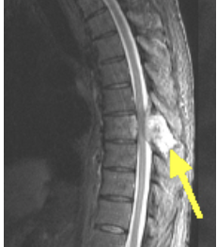
Spinal cord compression
Incidence: 3-5% in children with cancer
Most commonly results from tumor involving epidural or subarachnoid space
In pediatric patients, most commonly associated with neuroblastoma, sarcomas, NHL and germ cell tumors, but has been seen in other malignancies
44-72% of children have persistent neurologic deficits after treatment
meddean.luc.edu

Slide 21
Spinal cord compression
Clinical presentation
  Motor and sensory deficits, back pain, diplegia or quadriplegia, bowel or bladder incontinence
Management
  Immediate administration of dexamethasone (1 to 2 mg/kg, followed by 0.25 mg/kg every 6 hours)
  Following administration of steroids, emergent MRI should be performed
  Additional treatments can include laminectomy, radiation, or chemotherapy; approach depends on type of malignancy

Slide 22
References
Freifeld, AG et al. “Clinical Practice Guideline for the Use of Antimicrobial Agents in Neutropenic Patients with Cancer: 2010 Update by the Infectious Diseases Society of America”. CID (2011): 52(4): e56-e93.
Ganzel, C et al. “Hyperleukocytosis, leukostasis and leukapheresis: Practice management”. Blood Reviews (2012) 26, 117-122.
Henry, M. and Sung, L. “Supportive Care in Pediatric Oncology: Oncologic Emergencies and Management of Fever and Neutropenia”. Pediatr Clin N Am (2015) 62, 27-46.
Lerman, J. “Anterior Mediastinal Masses in Children”. Seminars in Anesthesia, Perioperative Medicine and Pain (2007) 26, 133-140.
“Pediatric Febrile Neutropenia Clinical Pathway”. University of Chicago Medicine, Comer Children’s Hospital.
Seth, Rachna, and Abdus Sami Bhat. "Management of Common Oncologic Emergencies." Indian J Pediatr The Indian Journal of Pediatrics (2011): 709-17. Print.

